Slide 1
New member orientation
<Date>
Please sign in and be seated.
We will begin at XX :a.m. / p.m. XX.
Notes:
Presenter notes: We’ve learned that a thorough orientation is an important member retention tool, so we prepared this presentation for you to share with new club members or potential new members.
Make this presentation your own. Save it electronically, fill in the blanks and tailor the slides to meet your club’s needs. If you decide to add new slides, please maintain the integrity of the Kiwanis graphic standards by using the “Insert New Slide” function.
This is designed as a 30 minute experience.
Here’s the equipment you’ll need:
Instructor’s guide (the PowerPoint notes pages)
A laptop computer, the PowerPoint file and an LCD projector if you are anticipating a large group
A handout of slides for participants (optional)

Slide 2
New member orientation
Topics we will cover today:
Who we are
The Kiwanis Club of NAME
Kiwanis International
Questions and wrap up
Notes:
Presenter notes: Click to bring in each topic.
Topics
Who we are— We will do a quick overview of who we as Kiwanians and where we are.
About our club— Every club has its own “flavor”, its own traditions and projects, and its own wonderful way of interacting with the community where it exists. We will talk more about our club and the things that make our club special and important to our community.
About Kiwanis International— While all clubs are unique, they share one thing in common– they are part of a strong international organization that supports the work of clubs around the world. We will briefly discuss Kiwanis International and the ways this organization supports our local club.
Questions and wrapping it up— At the end of our time together, we will take a few moments to answer questions that you might have about our club or Kiwanis International. Of course, our members will always be available to answer questions for you later as well.
Our goal for today is simple: to help you become familiar with our club and our organization as a whole. We believe that Kiwanis International offers a unique way to serve children due to the fact that our organization is global and has a large outreach, while keeping a focus on local issues and service to children. We are glad you have chosen to join us.
We will know we have met our goal today if you:
Learn new information about Kiwanis which you are able to share with others
Understand how our club functions in our community
Understand why Kiwanis International is important to our community and to the global community

Slide 3
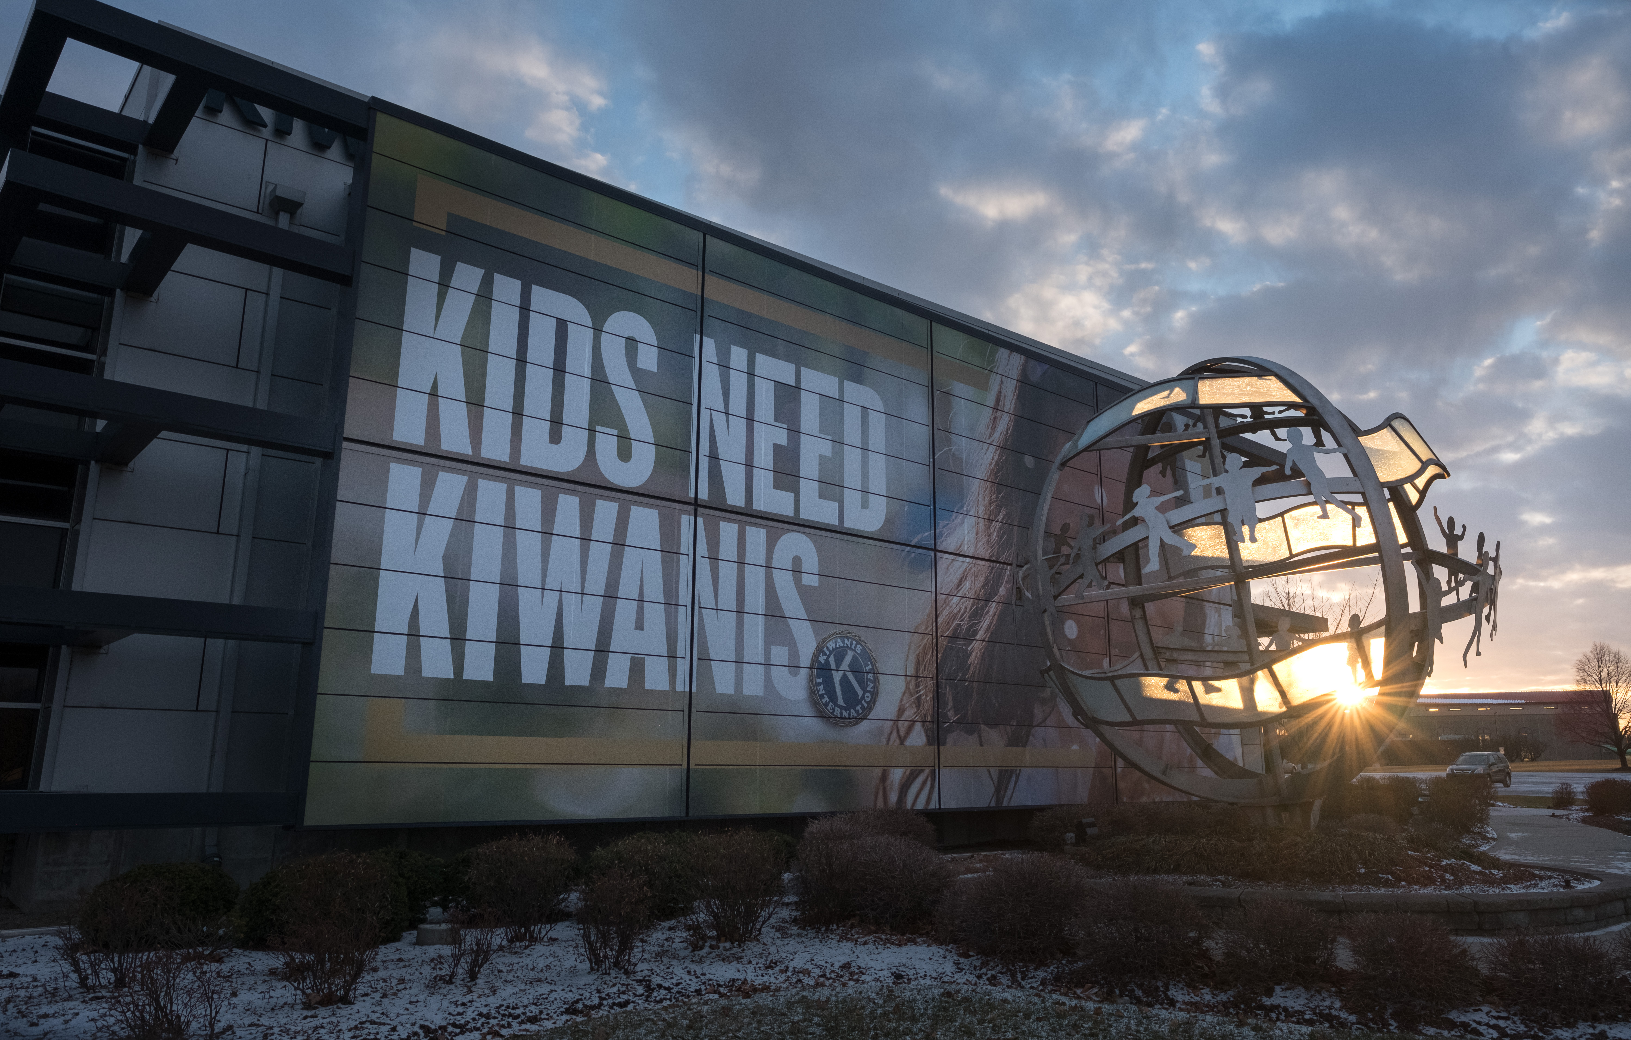
Welcome to Kiwanis!
Notes:
Presenter notes: For this slide, prepare a welcome in your own style.
We are excited that you’re joining our club, and we want to understand what attracted you to become a member. So tell me, what drew you to becoming a member in our club?
Knowing this will help us connect you to different members and activities to ensure your experience is valuable.

Slide 4
Who we are
Defining statement
Kiwanis is a global organization
of volunteers dedicated to improving the world
one child and one community at a time.
Notes:
Presenter notes: Presenters may want to memorize the defining statement and share it with others along with what the district and club are doing to improve the community.
The defining statement of Kiwanis International offers a quick and thorough answer to the question “What is Kiwanis?”
The more the community understands Kiwanis, the more they will want to join us. The more members we have, the more hands to be of service, thus the greater our impact in our community.

Slide 5
Who we are
Our motto: Serving the children of the world
What do we do?
Each year, Kiwanis clubs around the world:
Sponsor nearly 150,000 service projects
Devote more than 18.5 million hours to service
Raise more than US$100 million
Notes:
Our motto says it all….we are here to serve the children of the world. Our clubs do this by working in communities to better the lives of children through service projects and fundraising. Each year, our clubs sponsor nearly 150,000 service projects, devoting more than eighteen and half million hours to service. Our members also are fundraising to support those projects. We raise more than 100 million US dollars every year to fund our projects. So as you can see, our members adopt our motto and live it in their daily lives.
All figures approximate as of October 2017, and subject to change.

Slide 6
Who we are
Why are we here?
To improve lives through fellowship in service worldwide
Where are we?
More than 7,000 clubs in 79 nations and geographic areas
When did Kiwanis begin?
Founded in 1915 in Detroit, Michigan
Notes:
Presenter notes: Click to bring in each topic.
So, we are here to improve lives around us. And in doing so, we enjoy the fellowship of others in our community who are like-minded. But our community is not alone in this mission. While our club directly impacts our community, there are more than 7,000 clubs in 79 nations and territories. Together, our efforts are changing the world we live in. Kiwanis International has been doing this for more than 100 years and is more impactful than ever. We say kids need Kiwanis because Kiwanis is in the community to help meet the needs of children. Our clubs step in when county, city or school budgets are reduced and programs are cut. We help with book projects, food projects, playgrounds – everything a kid needs to be able to thrive, prosper and grow.

Slide 7




Kiwanis structure
Club
Division
Kiwanis International
District
Notes:
Presenter notes: Members will benefit from knowing more about your district and how your club fits in to the overall Kiwanis structure. If you’d like to present more information about your structure, contact your Kiwanis district office for the latest details.
This is how Kiwanis leadership is organized. It starts at the club level with our members. Our club belongs to a division with XX clubs and its own set of leaders, most notably a lieutenant governor who supports the clubs in the division. The next layer of leadership is the district which is led by our governor. There are 48 districts around the world. And, finally, we have Kiwanis International which houses all of the districts and provides support to all clubs through this structure.
As you can see, this multi-leveled leadership construction means our club is supported by a larger network of leaders who are prepared to help us be successful as we work to help our community.

Slide 8
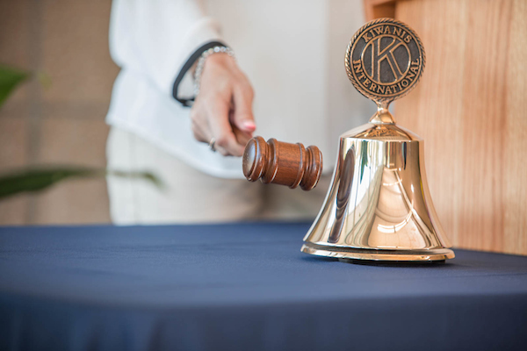
About our club
Kiwanis Club of NAME
Charter date:XXXXXX
Meeting day, time, and place
Notes:
Presenter notes: Insert details about your club.

Slide 9
Quick glance at our club
Add info about your club, such as committees, membership information, service projects, fundraisers, signature project, SLP sponsorships
Notes:
Presenter notes: The slides in this section are to be completed by your club officers. Please personalize these slides to relay information about your club to potential new members.

Slide 10
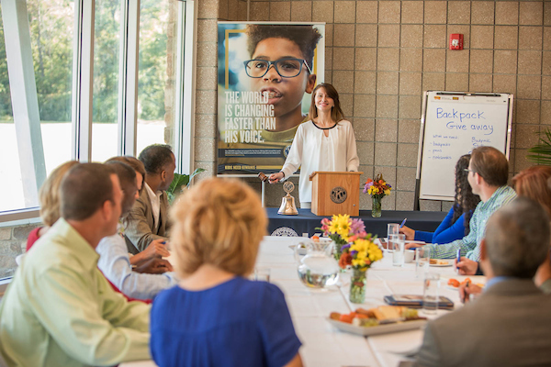
Our club’s committees
Financial review*
Membership
  Invitation/Retention
  Education
  Public relations
Programs
  Club meetings
  Special events
Service and fundraising
  Community services
  Service Leadership Programs
*This committee is required by the Kiwanis International Standard Form for Club Bylaws
Notes:
Presenter notes: Change this slide to reflect the club’s committees. Can insert photo of club if available.
Committees provide opportunities for participation and leadership. Each club has a list of standing committees within their bylaws and policies, and many clubs have continued to add committees for different functions, such as specific fundraisers and service activities.
These are the standard committees listed in the Standard Form for Club Bylaws and policies. Larger clubs may have more committees to provide more opportunities for members to get involved; some small clubs combine or prioritize these committees. Focus on the work the club needs or wants to accomplish. Describe what each committee does. Club committees are where the work gets done and relationships are forged. Encourage new members to find a committee that interests them and to play a part.

Slide 11
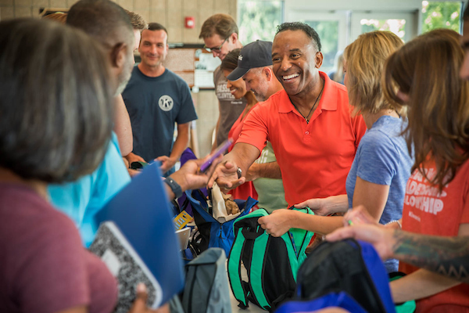
Our club’s service projects
[list here]
Notes:
Presenter notes: List the club’s major service projects and encourage the new member to participate.
Relationships are forged by participating in the activities of the club.
Give new members an opportunity to participate in a service project right away.
Find out if the new member has a particular interest in one of those or has suggestions for other projects.

Slide 12

Our club’s Service Leadership Programs
Name:
Meeting time:
Location:
Advisor:
Notes:
Presenter notes: Share with the new member which programs this club sponsors or supports. Members are encouraged to attend meetings. Add additional slides if needed.
Kiwanis International empowers people at every stage of life to become competent, capable and compassionate leaders by helping them learn to help others. Through its Service Leadership Programs, Kiwanis teaches students and adults ways to improve the world one child and one community at a time.

Slide 13
Our club’s fundraising projects
[list here]
Notes:
Presenter notes: List the club’s major fundraising projects.
As with service projects and committee assignments, relationships are forged by participating in the activities of the club.

Slide 14

Our club’s traditions
[list traditions]
Notes:
Presenter notes: Describe a typical club meeting including format and timing (and timeliness), seating (hopefully “open”) and club traditions such as Happy Dollars. Take time to explain to new members (and guests) what to expect (singing, meals, committee reports, etc.) so they feel comfortable at the first few club meetings.
Some clubs start meetings with an invocation and singing, some don’t. Assure the new member that his or her preferences will be considered when club traditions and club meetings are evaluated.
Be sure to evaluate your club’s traditions annually by asking your members if they meet their needs and expectations for their club.

Slide 15
Communication
  Newsletters
    KI Update;
    club, division and district
  Websites
    Club: [list club website here]
    Kiwanis International: kiwanis.org
Notes:
Presenter notes: Describe each of these communication vehicles. Take time to show members the Kiwanis International website, kiwanis.org. Share the URLs for your club and district websites too.
Sharing information is critical to keeping members engaged. When you join a Kiwanis club, the club secretary will enter your information in our database. Within a month you should receive the first of a series of emails welcoming you to Kiwanis. You also will receive a mailed packet with information about Kiwanis.

Slide 16
Communication
  Kiwanis magazine: kiwanismagazine.org
  Social media
    Kiwanis International
      Facebook: facebook.com/Kiwanis
      Twitter: @Kiwanis
      Instagram: @Kiwanis
    Club
      <Include club social media information here.>
Notes:
Presenter notes: Describe each of these communication vehicles. Take time to show members the Kiwanis International website, kiwanis.org. Share the URLs for your club and district websites too.
Sharing information is critical to keeping members engaged. When you join a Kiwanis club, the club secretary will enter your information in our database. Within a month you should receive the first of a series of emails welcoming you to Kiwanis. You also will receive a mailed packet with information about Kiwanis.

Slide 17

About our club
Club leaders
President:
Immediate past president:
President-elect or vice-president:
Secretary:
Treasurer:
Notes:
Presenter notes: Explain that officers change with each administrative year, which begins October 1.
Describe the election process for club directors and officers.
Explain what the annual club meeting is.
Share the date of the club’s next annual club meeting which is likely in April or May.
Encourage new members to consider running for office.

Slide 18
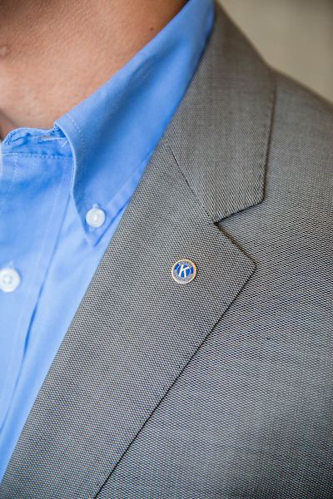
Club business
Members vote to:
  Elect club officers and directors
  Amend club bylaws
Board of directors:
  Determines club policies
  Approves club projects
  Approves and controls club’s budget
  Approves membership applications
  Manages the club
Notes:
Presenter notes: Briefly explain the structure of voting and the responsibilities of the board of directors for your club.

Slide 19
Board of directors meeting
  Time Date Location
  All members are welcome to attend
  Only board members can vote
Notes:
Presenter notes: Share with the new member the list of club board members.
Explain that all members are welcome to attend board meetings, but only board members and officers may vote.

Slide 20
Finance & budget
Administrative account
  Income from club dues, meal charges, new member fees
  For administrative expenses of club
Notes:
Presenter notes: Briefly describe the finances of the club and share whether or not the club has a foundation.
In the United States, Kiwanis clubs are classified as 501(c)4 organizations therefore, dues and donations are not tax deductible.
Some clubs have 501(c)3 foundations that can accept tax deductible contributions.

Slide 21
Finance & budget
Service account
  Income from public fundraising projects or contributions
  Cannot be used to pay club administrative expenses of the club
*Two separate accounts are no longer required by Kiwanis International. However, it is best practice to account for these two different types of funds in some way (coding, etc.).
Notes:
Presenter notes: Briefly describe the finances of the club and share whether or not the club has a foundation.
In the United States, Kiwanis clubs are classified as 501(c)4 organizations therefore, dues and donations are not tax deductible.
Some clubs have 501(c)3 foundations that can accept tax deductible contributions.

Slide 22
Member benefits
Club benefits
[list club benefits here]
Division benefits
[list division benefits here]
District benefits
[list district benefits here]
Kiwanis International member benefits
kiwanis.org/marketplace
Notes:
Presenter notes: Include club, division or district benefits (i.e. district and club newsletters, education conferences, leadership education, social and networking experiences). Delete any content that is not relevant to your club and add additional slides if necessary.
Also note Kiwanis International member benefits found at kiwanis.org/marketplace

Slide 23

Become involved
  Attend club meetings
  Participate in service and fundraising projects
  Attend district council meetings
  Participate in inter-club meetings
  Serve on committees
  Run for office
  Spread the word about Kiwanis
Notes:
Presenter notes: Click to bring in each topic. Edit the list to reflect ways new members can become involved in your club.
There are a number of ways to be involved with your club. We know you lead a busy life and understand that you are here to help in any way you can—we are grateful. Here is a list of common ways that members help our club.

Slide 24
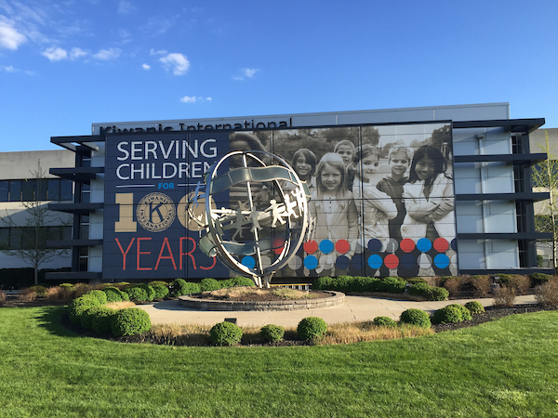
Kiwanis International
Centennial
Celebration
Notes:
Kiwanis International celebrated its centennial in 2015 with a series of visits to districts around the world. Each of the districts built a playground, our way of giving back to the communities and giving children the gift of play. We’ve had more than 100 years of serving the children of the world and through clubs like ours, Kiwanis has maintained a reputation as an outstanding service organization.

Slide 25
The Kiwanis Objects
To give primacy to the human and spiritual rather than to the material values of life.
To encourage the daily living of the Golden Rule in all human relationships.
To promote the adoption and the application of higher social, business and professional standards.
Notes:
Instructor notes: Review the 6 Kiwanis Objects (2 slides total)
The Kiwanis International Objects are our guiding principles. They were approved by Kiwanis club delegates at the 1924 convention in Denver, Colorado. They’ve inspired generations of Kiwanians—and they still hold true today.

Slide 26
The Kiwanis Objects
To develop, by precept and example, a more intelligent, aggressive and serviceable citizenship.
To provide, through Kiwanis clubs, a practical means to form enduring friendships, to render altruistic service and to build better communities.
To cooperate in creating and maintaining that sound public opinion and high idealism which make possible the increase of righteousness, justice, patriotism and goodwill.
Notes:
(Continue to review the Objects)
These objects are the driving force behind everything Kiwanis does. But it takes strong leadership to keep any group of people focused on the mission at hand. Kiwanis International supports a structure of leadership which helps clubs fulfill their primary purpose.

Slide 27
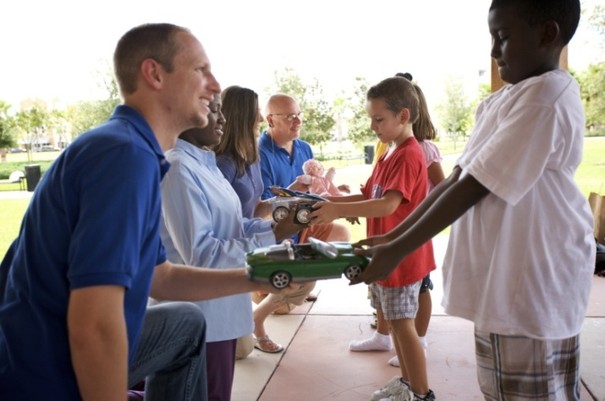
Benefits of membership
Change children’s lives
Improve your community
and the world
Build friendships
Enhance leadership skills
Networking
Notes:
Instructor notes: Click to bring in each topic.
We hope to get you involved quickly in our service projects. We feel it is important that new members have an opportunity to participate in a service project right away. We want you to understand that feeling of pride and fulfillment that comes from being a part of an organization that makes a difference. This feeling of accomplishment is only one of the benefits of being a part of our local Kiwanis club. (Discuss other benefits on slide. You may use the script below, add to it or create your own comments regarding the benefits listed.)
As a member of Kiwanis, you have the chance to change the lives of children all around the world. You will act locally in our community to improve the lives of area children, but our impact as an organization is felt worldwide. You will no doubt build new friendships through serving side-by-side with like-minded people. You will enhance your own leadership skills, and help develop leadership skills in the children we serve. You can also develop business contacts through your relationships in the club and the community. It is what we like to call a “win-win” situation, one where you benefit from being of service to others.

Slide 28
Kiwanis Children’s Fund
  Charitable entity of Kiwanis International
  5 Kiwanis cause areas:
    disaster relief
    SLP
    club and district service projects
    The Eliminate Project
    sustained elimination of iodine deficiency disorders
Notes:
Presenter notes: Differentiate between the Kiwanis Children’s Fund and district/club foundations.
The Kiwanis Children’s Fund solicits donations directly from our members (via postal mail and sometimes via email). Share with the new member any other ways that the club also supports the Kiwanis Children’s Fund.
With the Kiwanis Children’s Fund, every gift matters. In fact, your generosity helps children in many places, in many ways. The Children’s Fund has five areas of support: disaster relief, SLPs, club and district service projects, The Eliminate Project and the sustained elimination of iodine deficiency disorders.
You can serve children today with a gift to the Kiwanis Children’s Fund – with the five areas of support, you can determine the area that you want to support.
You can even serve children forever—by including our fund in your estate plans.
There’s no shortage of giving opportunities. To learn more, visit http://www2.kiwanis.org/childrensfund/about-the-childrens-fund#.WnDMZainHIU
The Kiwanis Children’s Fund:
Supports the Kiwanis community on a global scale.
Provides the recognition and publicity for club contributions.
Provides money for matching scholarships to Key Clubs and Circle K clubs in your district.
Provides grants to clubs and districts to provide service to children.
Provides funds to support Kiwanis family programs at the International level.

Slide 29
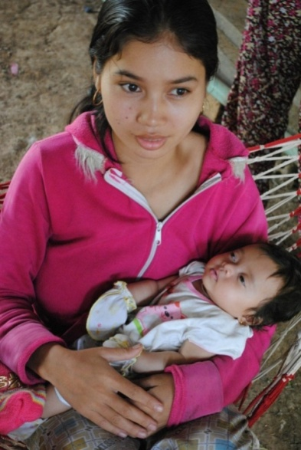
The Eliminate Project
  Partnership with UNICEF
  Goals:
    Eliminate maternal/neonatal tetanus
    Raise US$110 million
    More information: TheEliminateProject.org
Notes:
Presenter notes: Share your club’s plans for involvement in the project.
This is Kiwanis International’s global campaign for children. Our goal is to raise $110 million to fight maternal/neonatal tetanus. Our clubs secure pledges and raise funds that are used by UNICEF to deliver the MNT vaccine in remote locations where tetanus remains a health risk. The disease has been eliminated in 44 of the original list of 59 countries. We’ve collected US$70 million in cash and continue to work to meet our pledge goals.
More information is available at TheEliminateProject.org
.

Slide 30







Service Leadership Programs
  The largest and oldest youth service clubs in the world
  Program for adults living with disabilities
  Over 367,000 members worldwide
Notes:
Presenter notes: Ask about new members’ experiences with the Service Leadership Programs. Many are familiar with Key Club and Circle K International but may not associate the programs with Kiwanis.
We define Service Leadership as the next step beyond service learning. Once a young person fully understands the concept of learning by helping others, he or she begins to grow personally as a leader. Our Service Leadership Programs are a great way to inspire the next generation of leaders. The visibility of our Service Leadership Programs can also be a positive incentive for parents, teachers, school administrators, youth ministers, and others interested in the welfare of students.

Slide 31
Kiwanis partners
  Kiwanis partners bring value to your club by providing services and products that enhance our service and
  work in the community.
  Kiwanis partners and resources: kiwanis.org/partners
Notes:
Presenter notes: (Read the slide)
Kiwanis International believes in working collaboratively with businesses and organizations that share in our dedication to serving children. Here are some of our national partnerships: Landscape Structures Inc., for playground equipment; the Army; Scholastic Books; Nickelodeon, Boy Scouts, Children’s Miracle Network Hospitals – more information and a complete list is on the website at kiwanis.org/partners
Our partner’s products, services and reputation must:
Be compatible with and complementary to Kiwanis’ mission and values
Reflect a high degree of integrity
Demonstrate a track record of high-quality products or services
There is nothing that prevents your club from partnering with a local vendor or organization that has common values and is working with your clubs to meet the needs of children in your city or town.

Slide 32
Conventions
  District midyear conference
  District convention
  Kiwanis International convention
  Key Club International convention
  Circle K International convention
Notes:
Presenter notes: Discuss dates and locations of upcoming conventions and, if appropriate, club policies for sending members to each of these events.
Kiwanis International conducts an annual convention, which is held to:
Elect International Board members
Amend the International Bylaws
Provide Kiwanis fellowship
Provide Kiwanis education
Each club is allowed to have two delegates and two alternates. These delegates compose the House of Delegates and vote on the election of officers and new members to the Board of Trustees, resolutions, and proposed amendments to the Kiwanis International Bylaws. District conventions and conferences achieve the same objectives but at the district level. Some districts have regional meetings.

Slide 33
Questions?
Notes:
Open the floor to questions.

Slide 34
Wrapping it up
Contact information:
  (who to contact for more info)
Our next meeting:
  (Fill in time and date)
Notes:
Instructor notes: Supply contact information for a couple of club members who are available to answer questions that attendees might have after the meeting adjourns. You might also supply the meeting time and date for the next meeting.
Another idea is to assign a club member to contact these people a couple of days prior to the next meeting so that they know they are invited to attend. It always helps to reach out and help new people feel welcomed!

Slide 35
Thank you for attending!
We hope you will enjoy being a part of our club and serving the children of the world.

