Slide 1
Diversity, Equity and Inclusion This presentation was created by the Kiwanis International 2021-22 DEI Committee.
Notes:
MODERATOR:
Welcome.
As you know, Kiwanis International serves children around the world. We have members in more than 70 countries.
With that kind of international reach, Kiwanis is committed to opportunity and dignity for all people.
It’s important for an organization like ours to state its principles.
In June 2022, the Kiwanis International Board of Trustees adopted a detailed statement of our continuing commitment to diversity, equity and inclusion.
You can find it at Kiwanis.org/diversity.

Slide 2
Not everything that is faced can be changed, but nothing can be changed until it is faced. -James Baldwin
Notes:
Read the quote.
Kiwanis is striving to become a more diverse, equitable and inclusive organization for all to serve. We cannot begin this work, however, until we acknowledge that our organization must begin to adopt new ways of thinking, operating and bring it into the values of the 21st century.

Slide 3
Educational objectives
To define, describe and explore examples of diversity, equity and inclusion.
To apply these examples to a healthy Kiwanis club experience.
To provide resources for further exploration on the topics of diversity, equity and inclusion.
Notes:
MODERATOR:
This session is designed to be a general overview about diversity, equity and inclusion.
As we discuss this, we will apply this exploration through a Kiwanis lens, both as a member and as it applies to a Kiwanis club.
We will also look at resources for further exploration on these topics.

Slide 4
Community guidelines
You may feel uncomfortable discussing some of the topics. That’s OK.
Be an active listener.
Avoid making assumptions about other people’s identities.
What is shared here stays here, and what is learned here leaves here.
Notes:
MODERATOR:
When I share the words “diversity, equity and inclusion,” what comes to your mind?
PAUSE FOR RESPONSES
As a global service organization, we have a mission to serve the children of the world. This means understanding that, as Kiwanians, we make an impact both locally in our communities and globally.
As we proceed, I’d like for us to agree to the four community guidelines on the screen.
I acknowledge that you may feel uncomfortable discussing some of the topics. That’s OK.
Be an active listener.
Do not make assumptions about other people’s identities.
What is shared here stays here, and what is learned here leaves here.
Would anyone else like to contribute a community guideline?
PAUSE FOR RESPONSES

Slide 5
Not on today’s agenda
Blaming or shaming.
Forcing a “hidden agenda” on you.
Taking a political stance.
Notes:
MODERATOR:
For some, conversations about diversity, equity and inclusion elicit negative thoughts or ideas.
This discussion is not designed to do that.
As such, we will not be blaming or shaming anyone, forcing a hidden agenda or taking a political stance.

Slide 6
Commitment to DEI*
Kiwanis clubs shall not discriminate based upon race, color, creed, national origin, age or sex, including sexual orientation and gender identity, when considering membership or during any of their activities or operations and shall conduct business in compliance with local nondiscrimination laws.
*Diversity, Equity and Inclusion
Source: Kiwanis International Bylaws, Article VIII, Section 10
Notes:
MODERATOR:
Kiwanis International has a nondiscrimination statement. You can find that statement in the Kiwanis International Bylaws, Article VIII, Section 10.
This statement was last updated at the 2019 Kiwanis International Convention held in Orlando, Florida, USA.
REQUEST: Who would like to volunteer to read the statement that was voted on, approved and added to the Kiwanis International Bylaws during the House of Delegates in 2019?

Slide 7
Committee on DEI
Vanessa McClary, Chair Indiana District
Amanda Brown | Illinois-Eastern Iowa District
Celia Earle | Florida District
Michael Hipple | Wisconsin-Upper Michigan District
John Holley | Georgia District
Maura Magni | Italy-San Marino District
Bobby Moo Young | Eastern Canada and Caribbean District
Tsuyoshi Nakai | Japan District
David Olinger | Kentucky-Tennessee District
Gina Roberts | California-Nevada-Hawaii District
Shawn Smith | Pennsylvania District
Sandra Stocz-Fenton | Ohio District
Angela Evans | Kiwanis Staff Liaison
Notes:
MODERATOR:
Past Kiwanis International President Art Riley (2020‐21) appointed a Kiwanis International committee on diversity, equity and inclusion that was formally seated on October 1, 2020.
The committee is chaired by past Indiana District Governor Vanessa McClary (2013-14) and is comprised of 12 members plus one staff liaison. The committee meets monthly to examine the role of diversity, equity and inclusion in Kiwanis and has been building a website with resources and training materials and gathering feedback from members and leaders.

Slide 8
Definition: Diversity
Diversity is expressed in myriad forms, including
race and ethnicity, gender and gender identity, sexual orientation, socioeconomic status, language, culture, national origin, religious commitments, age, (dis)ability
status and political perspective.
Source: University of Michigan, https://diversity.umich.edu/about/defining-dei/
Notes:
MODERATOR:
There are many definitions of diversity, equity and inclusion. Many of them overlap, and all share core content.
For today’s conversation, we are going to look at the terms diversity, equity and inclusion as defined by the University of Michigan.
MODERATOR: Ask someone to read the definition.
QUESTION: Does anyone have questions about this definition?
PAUSE FOR RESPONSE

Slide 9
Definition: Equity
Equity is the fair treatment, access, opportunity and advancement for all people, while at the same time striving to identify and eliminate barriers that prevent the full participation of some groups.
Source: University of Washington, https://environment.uw.edu/about/diversity-equity-inclusion/tools-and-additional-resources/glossary-dei-concepts/
Source: University of Michigan, https://diversity.umich.edu/about/defining-dei/
Notes:
MODERATOR:
Ask someone to read the definition.
QUESTION: Does anyone have questions about this definition?
PAUSE FOR RESPONSE
MODERATOR: Equity can be a difficult topic to grasp and is easily conflated with equality.
PAUSE FOR RESPONSE

Slide 10
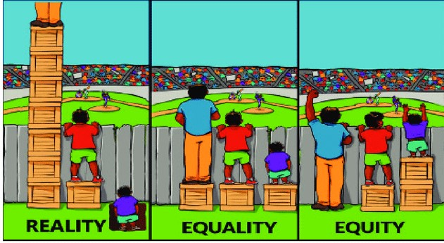
Definition: Equity
Source: Original graphic from Interaction Institute for Social Change | Artist: Angus Maguire. interactioninstitute.org and madewithangus.com.
O
Notes:
MODERATOR: What is the difference between equity and equality? It is about fair opportunity
and creating a level playing field, rather than equal treatment.
QUESTION: Any questions about this definition?
PAUSE FOR RESPONSE

Slide 11
Definition: Inclusion
Inclusion is building a community (club) where differences are welcomed, different perspectives are respectfully heard and every individual feels a sense of belonging.
Source: University of Michigan, https://diversity.umich.edu/about/defining-dei/
Notes:
MODERATOR:
Ask someone to read the definition.
QUESTION: Does anyone have questions about this definition?
PAUSE FOR RESPONSE

Slide 12
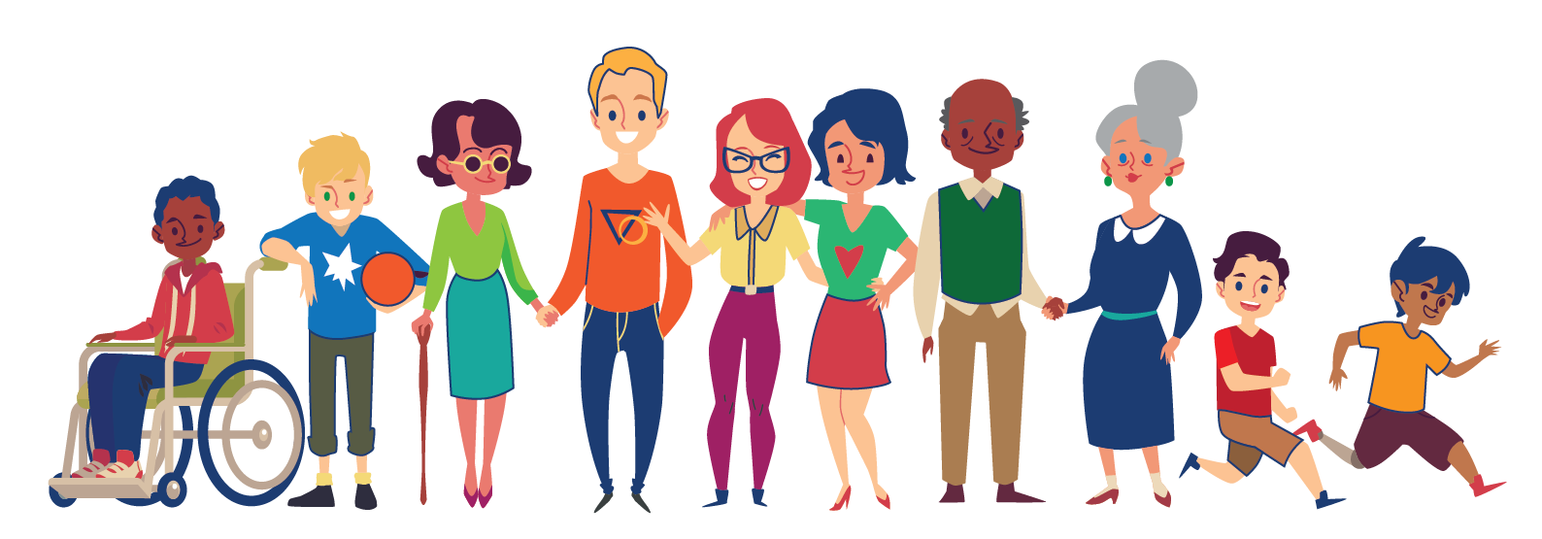
Definition: The dance
Diversity is when everyone is invited to the party.
Equity means that everyone gets to contribute to the playlist.
Inclusion means that everyone has the opportunity to dance.
Notes:
MODERATOR:
To provide an example of diversity, equity and inclusion, let’s use them in the context of planning a dance party.
Diversity is when everyone is invited to the party.
Equity means that everyone gets to contribute to the playlist.
Inclusion means that everyone has the opportunity to dance.
Further, diversity is a fact, equity is a choice and inclusion is the goal.
PAUSE FOR REACTIONS/COMMENTS

Slide 13
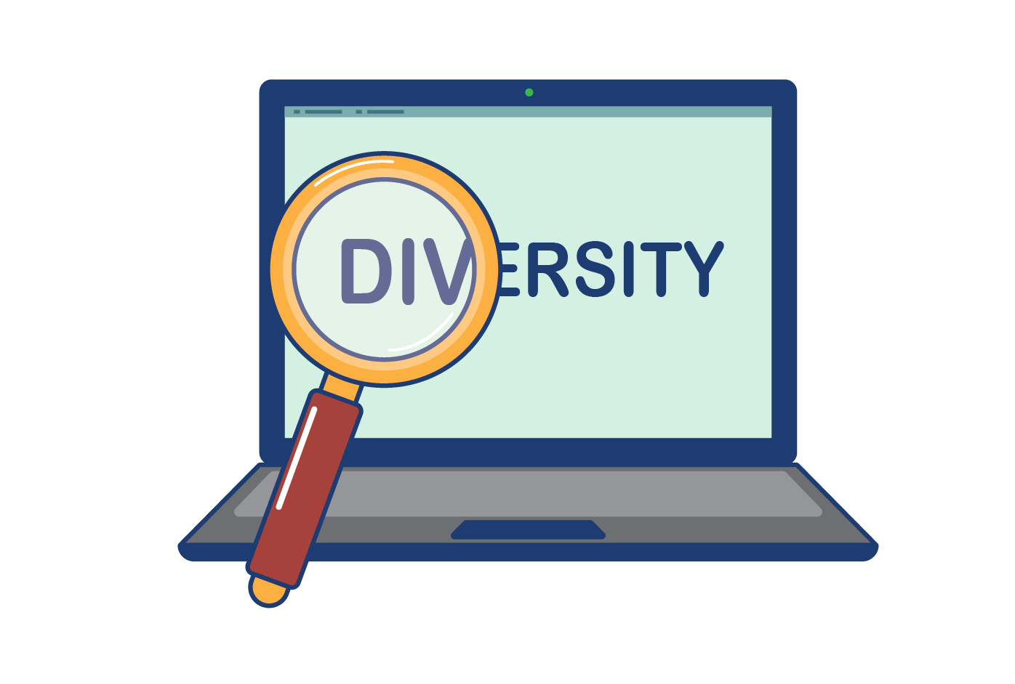
Why DEI and Kiwanis?
Notes:
QUESTION: Why do you think we are talking about DEI?
PAUSE FOR RESPONSE

Slide 14
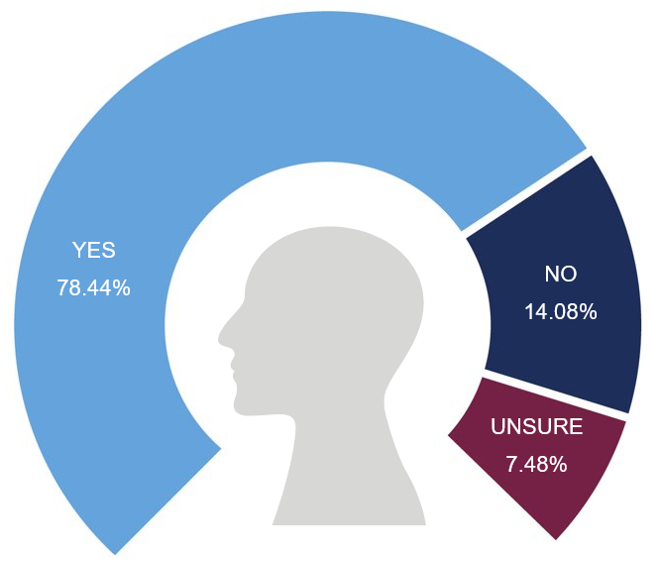
Survey results
Do you believe diversity, equity and inclusion are topics for our organization to discuss?
Yes – 78.44%
No – 14.08%
Unsure – 7.48%
Notes:
MODERATOR:
In April 2021, Kiwanis members in the United States received a survey seeking to gain insight about diversity, equity and inclusion as they apply to Kiwanis membership.
The survey was developed by the committee on diversity, equity and inclusion and approved by the Kiwanis International Board and Leadership Team.
The survey questions were carefully vetted by outside experts and consultants who donated their time and talent.
The survey was collected by a third‐party vendor, ensuring that it was completely anonymous.
Kiwanis received 4,576 responses.
An overwhelming 78% of those respondents replied “yes,” diversity, equity and inclusion are topics for our organization to discuss.

Slide 15
Did you know …
Average age of a Kiwanis member: 60.
Average age of a new Kiwanis member: 48.
Percentage of male members: 68%.
Percentage of female members: 32%.
What does this tell you about a typical Kiwanian as it relates to DEI?
Notes:
MODERATOR:
Additional data that we know about today’s Kiwanian:
The average age of a Kiwanis member is 60.
The average age of a new Kiwanis member is 48.
68% of our members are male.
32% of our members are female.
QUESTIONS TO ASK:
What do these numbers tell you about a typical Kiwanian as it relates to DEI?
What does this mean for Kiwanis 10 years from now?
PAUSE FOR RESPONSE

Slide 16
Looking forward …
Kiwanis needs to stay
relevant in today’s
communities for
today’s youth.
Notes:
MODERATOR:
Looking at the data, it is important that Kiwanis stay relevant in today’s communities and for the youth.

Slide 17
Today’s youth:
Are achievement and service oriented.
Want to make a positive impact.
Are very aware of their community and how they can be social mavericks.
Don’t read newspapers.
Are drawn to sustainable products and brands that change to remain relevant.
Are very aware of DEI.
Notes:
MODERATOR:
Social scientists know quite a bit about today’s youth — those ages 25 and younger, our next generation of Kiwanians.
They are high achievers and service oriented.
They are community minded and want to make a positive impact.
They are change agents, often called “social mavericks,” who share their values and beliefs on social media.
They don’t read newspapers; they get their news from social media and short YouTube and TikTok videos.
They are drawn to sustainable products and brands that change to remain relevant. (This will be important as we look at the typical Kiwanis club).
They are very aware of diversity, equity and inclusion. The concept has been part of their lives for a long time, and many are very passionate about it.

Slide 18
Why DEI and Kiwanis?
Notes:
QUESTION: Looking at those last couple of slides — Kiwanis members and today’s youth — why is DEI relevant to Kiwanis?
PAUSE FOR RESPONSE

Slide 19
Survey results
Which of the following have made you feel unwelcome, unsafe, unheard or not empowered as a member of Kiwanis? Check all that apply.
Notes:
MODERATOR:
As part of the April 2021 survey, the following question on diversity was asked:
“Which of the following have made you feel unwelcome, unsafe, unheard or not empowered as a member of Kiwanis?”
This question was designed to explore inclusion in our Kiwanis clubs. If members don’t feel included or welcomed, they will most likely leave.
LEAVE SLIDE UP FOR A BRIEF MOMENT

Slide 20
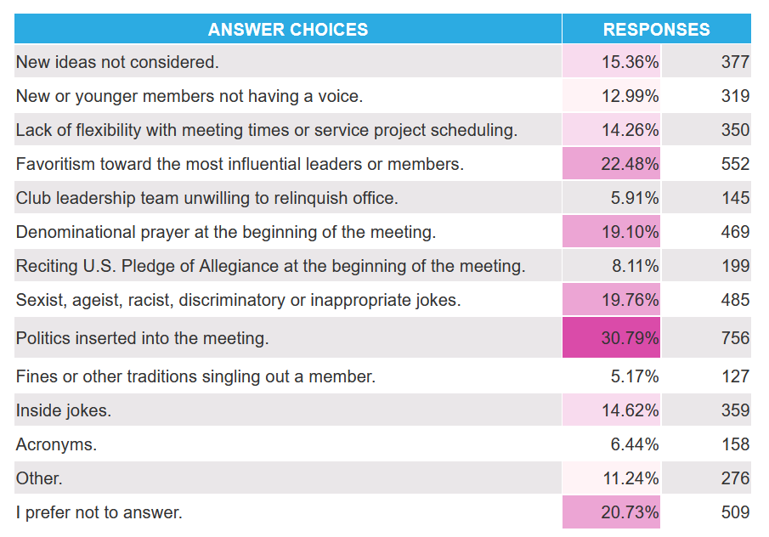
Notes:
LEAVE SLIDE UP FOR A BRIEF MOMENT

Slide 21
Taking a closer look …
Politics inserted into meetings.
Favoritism.
Sexist, ageist, racist, discriminatory or inappropriate jokes.
Denominational prayer.
New ideas not considered.
Lack of flexibility with meeting times or service project scheduling.
Notes:
MODERATOR:
Let’s take a closer look at the responses to the question, “Which of the following have made you feel unwelcome, unsafe, unheard or not empowered as a member of Kiwanis?”
In rank order, the highest ranked are:
Politics inserted into meetings.
Favoritism toward the most influential leaders or members.
Sexist, ageist, racist, discriminatory or inappropriate jokes.
Denominational prayer at the beginning of the meeting.
New ideas not being considered.
Lack of flexibility with meeting times or service project scheduling.
QUESTION: What are your thoughts/reactions to this?
PAUSE FOR RESPONSE

Slide 22
What does that tell you about diversity, equity and inclusion and Kiwanis?
Notes:
MODERATOR:
What does that tell you about diversity, equity and inclusion and Kiwanis?
PAUSE FOR RESPONSE

Slide 23
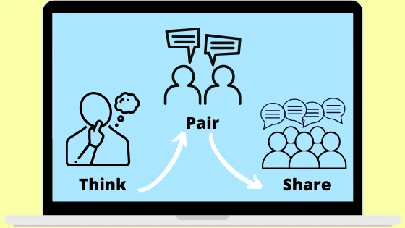
Diversity: Kiwanis Club
Source: W.W. Norton & Company
Notes:
MODERATOR:
Let’s take a couple of minutes and discuss what a healthy club looks like through a diversity lens.
We’ll examine equity and inclusion, as well. For now, let’s focus on “diversity” — when everyone is invited to the party.
PAUSE AND LET PARTICIPANTS DISCUSS IN PAIRS.
BRING EVERYONE BACK TOGETHER AND ASK PARTICIPANTS TO SHARE RESPONSES.

Slide 24
Equity: Kiwanis Club
Source: W.W. Norton & Company
Notes:
MODERATOR:
Now, let’s do the same thing but discussion equity –where everyone gets to contribute to the playlist –as it applies to a healthy club.
PAUSE AND LET PARTICIPANTS DISCUSS
BRING EVERYONE BACK TOGETHER AND ASK PARTICIPANTS TO SHARE RESPONSES.

Slide 25
Inclusion: Kiwanis Club
Source: W.W. Norton & Company
Notes:
MODERATOR:
Finally, let’s examine what inclusion looks like for a healthy club — when everyone has the opportunity to dance.
PAUSE AND LET PARTICIPANTS DISCUSS IN PAIRS.
BRING EVERYONE BACK TOGETHER AND ASK PARTICIPANTS TO SHARE RESPONSES.

Slide 26
Notes:
MODERATOR:
Let’s pause for a minute.
What are you thinking?
Does anyone have questions so far?
PAUSE FOR RESPONSE

Slide 27
Resources for your club:
Understanding unconscious bias.
Short video and discussion series.
Work with CKI and Key Club to have discussion groups about DEI.
Notes:
MODERATOR:
As we begin to wrap up our conversation about DEI and Kiwanis, let’s look at some resources for your club:
Consider hosting a workshop or conversation about understanding unconscious bias. Unconscious biases, also known as implicit biases, are the underlying attitudes and stereotypes that people unconsciously attribute to another person or group of people, affecting how they understand and engage with a person or group.
Consider hosting a short video and discussion series in your club. Similar to a book club, this opportunity allows members to view educational videos about diversity, equity and inclusion and discuss them afterward. A good example of such a video is “The Look” by Procter and Gamble, a 2019 TV commercial.
Partner with your CKI club and Key Club to have discussion groups about DEI.
Consider inviting a moderator with experience facilitating DEI conversations to these meetings or workshops. Don't assume that moderators will do this work for free. A small fee might be involved.

Slide 28
Resources for your club:
Notes:
MODERATOR:
Let’s look at a 2019 video created by Proctor & Gamble for the company’s #TalkAboutBias initiative.
https://www.youtube.com/watch?v=bhro7IXnc2E
QUESTION: What are your thoughts on biases after watching this video?
PAUSE FOR RESPONSE

Slide 29
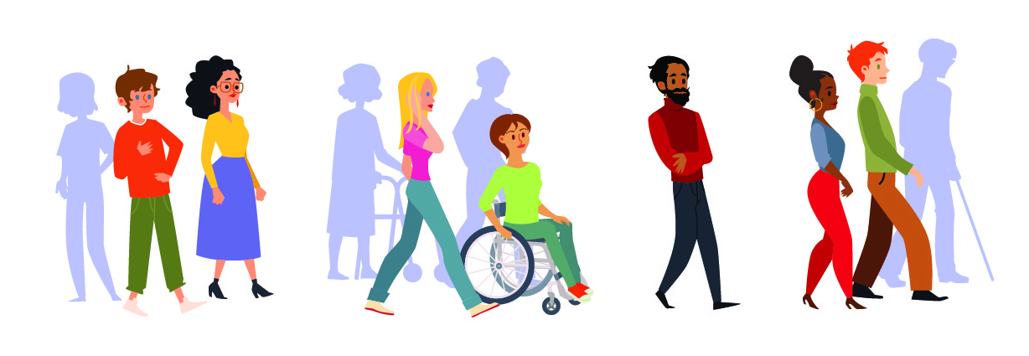
Resources for your club:
The Privilege Walk activity (facilitated)
Notes:
MODERATOR:
Additionally, the Privilege Walk activity looks at social privileges that benefit some individuals over others.
While the idea is to have members physically walk together, this activity can be adapted for a virtual audience and those with limited mobility.

Slide 30
Questions? Email: diversity@kiwanis.org
Notes:
MODERATOR:
For any additional questions about Kiwanis’ DEI initiatives or this DEI workshop, please email diversity@kiwanis.org.
In addition, the kiwanis.org website has a section devoted to DEI resources for clubs and districts. Visit kiwanis.org/diversity for more information.

